Slide 1
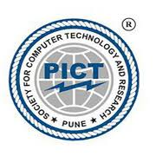
Pune Institute of Computer Technology, Pune Dept. of E&TC
304200: Mini Project (MP) (2019 Course)
“Smart Socket”
Guided By: Miss.Jyoti Sandur
By:
1) Aditi Funde
2) Chinmay Deshmukh
3) Disha Chinchole

Slide 2
Introduction
A smart socket is a small adapter that can be plugged into a regular electrical wall outlet.
It saves electricity consumption. It is connected to a Wi-Fi network. Without a Wi-Fi connection, you won't be able to control your smart plug.
The main goal for the device is to consume very less power at all times.
The smart plug is very economical and user-friendly for homes and industries. We can access the device from anywhere.

Slide 3
Aim and Objectives
Aim: To build a smart Wi-Fi socket that enables to control AC loads wirelessly through a smartphone.
Objectives:
1. To explain the concept of smart sockets, their components, and how they can be used to control electrical devices remotely.
2. To provide recommendations for selecting and using smart sockets based on the user's needs, preferences, and budget.
3. To identify and assess the advantages and disadvantages of using smart sockets, including their impact on energy efficiency, convenience, and security.

Slide 4
Block Schematic
Socket
ESP8266
Wi-Fi Module
LED
230V AC,5V DC Converter
5V Relay Module
Power Supply

Slide 5
resources Required
A compact ESP8266 Wi-Fi Module is required which can be used as a station or access point.
A circuit that converts 230V AC to 5V DC Power Supply Power.
Relay circuit that uses a low level triggered control signal.
A LED in order to ensure its working, Red LED ensures the working of components whereas Green ensures the output of the circuit.
AC Socket and plug along with connecting wires.

Slide 6
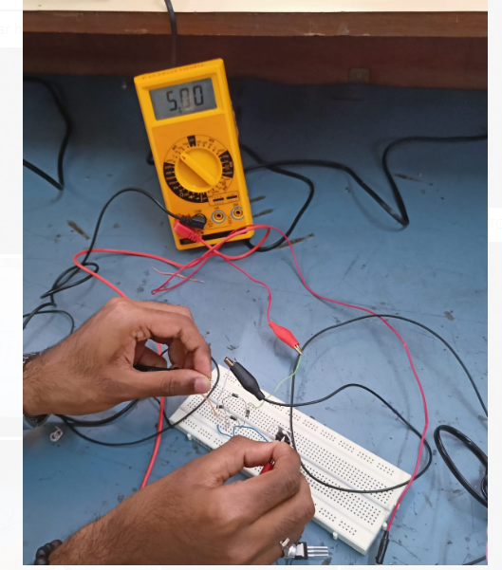
Breadboard testing

Slide 7
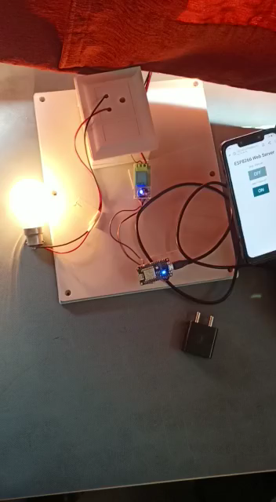
Working Demonstration

Slide 8
Market Analysis (Bill of Materials)
Components | Specification | Cost Analysis | Final Cost
Relay Module | 5V | 290/- | 200/-
ESP Module | ESP8266 | 200/- | 180/-
Bulb | 100W | 220/- | 220/-
Power supply | 5V | 350/- | 260/-
AC Socket | 3 pin | 150/- | 120/-
Original Cost | Reduced Cost
1230/- | 980/-

Slide 9
Features, future Scope
Integration with smart home systems:
Smart sockets will continue to integrate with other smart home devices, allowing homeowners to control their lights, security systems, and other appliances with a single command.
Remote monitoring:
With the ability to control and monitor appliances from a mobile device, smart sockets will become increasingly popular for remote monitoring. Homeowners will be able to check the status of their appliances, turn them on or off, and receive alerts if anything goes wrong, all from their phone or tablet.

Slide 10
References
List as per IEEE format:
A Smart Switch Control System Using ESP8266 Wi-Fi Module Integrated with an Android Application S. P. Makhanya, E. M. Dogo, N. I. Nwulu, U. Damisa Dept. Electrical and Electronic Engineering Science University of Johannesburg South Africa
Book:
The 2023-2028 World Outlook for Smart-Connected Power Plug Socket Wi-Fi Connectivity by : Prof Philip M. Parker
Weblinks:
https://ieeexplore.ieee.org/document/8805944
https://ieeexplore.ieee.org/document/9112377

Slide 11


